Slide 1


Bapuji Educational Association (Regd)
A.R.G. COLLEGE OF ARTS & COMMERCE, DAVANGERE.
A profile of the Department of
KANNADA
2017-18 TO 2021-22
Power point presentation of the Department
To NAAC peer team

Slide 2
DEPARTMENT OF KANNADA
ARG COLLEGE OF ARTS AND COMMERCE,
DAVANGERE.
HEARTLY WELCOME
THE NAAC PEER TEAM
Chair Person :
Member coordinator :
Member :

Slide 3


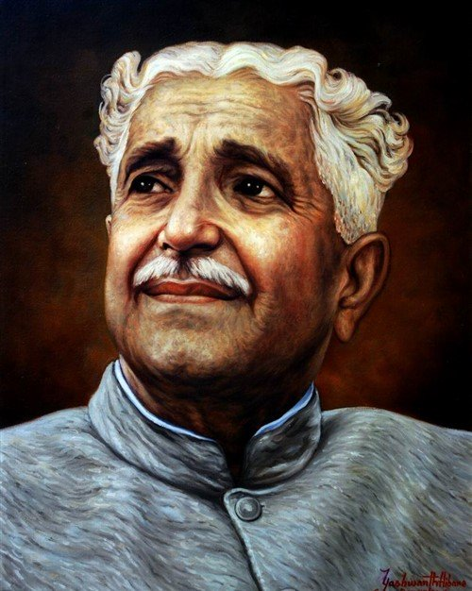




JNANAPEETA LAUREATE
RASHATRAKAVI KUVEMPU
PÀ
£Àß
qÀ
«
¨sÁ
UÀ

Slide 4
1.VISION
1.VISION
KANNADA – ONE OF THE CLASSICAL LANGUAGES OF
INDIA
TO CREATE AWARENESS OF THE LANGUAGE AND LINGUSTIC DIMENSIONS AND TO IMPART UARIOUS SKILLS LIKE WRITING OF CREATUE LITERATURE TO THE STUDENTS FOR ENHONCING THER CREATIUITY

Slide 5

2.MISSION
Dept of Kan
INTRODUCING INNOVATIVE
METHODS OF TEACHING,
THE CURRICULUM AND PREPARING STUDENTS TO PARTICIPATE IN
THE LITERARY FIELF BY IMPROVING THEIR KNOWLEDGE AND TO MAKE THEM TO LEAD VALUABLE LIFE

Slide 6

D
E
P
T
O
F
K
A
N
N
A
D
A
3. ABOUT THE DEPARTMENT
The Department of Kannada has been functining since the inception of the institution in 1973 kannada language is taught as a compulsory subject in all the courses for first & second year students of Arts and Commerce
The Department has dedicated, well experienced and fervent faculty with Ph.D and M.Phil Degrees
The students of the Kannada Department are being sent to participate in the literary activities and the competitions organized by Kannada Sahitya Parishat and other literary organization

Slide 7
4. The goals and objectives of the Department
Making the students more intellectual
To dig out the hidden talents of the students
Imparting interdisciplinary knowledge to the students .
To bring into focus the cultural and civilized importance
To bring out Departmental news letter with contributions By the teachers and students

Slide 8
5. Methods of Teaching
D
E
PT
OF
KANNADA
Lecture method
Recitation of self composed poems related to the lesson
Participative teaching
Group discussions
Interactions
Guest Lectures
Seminars, Assignments

Slide 9
6. GUIDANCE OF AVENUES FOR STUDENTS AFTER COMPLETING DEGREE
D
E
R
T
O
F
K
A
N
N
A
D
A
Competitative Examinations like KAS,KES
M.A., B.Ed course
Information about the coaching classes for competitive examinations
Self employment avenues
Creative writing skills

Slide 10
7.Department of kannada
ARG COLLEGE OF ARTS AND COMMERCE,DAVANGERE
Faculty Details
Year of Commencement of the Department : 1973
(since the establishment of college)
Sl. No | Name | Designation | Qulification | Date of joining | experience | workload
01 | Dr,H.R.THIPPESWAMY | ASSISTANT PROFISOR | M.A,Ph,D NET | 20.09.2021 | 12 | 16 Hrs

Slide 11
D
E
P
T
O
F
K
A
N
N
A
D
A
8. WORK -LOAD
A. No.of posts sanctioned - 03
Working - 01
Vacant - 02
B. Existing work load of Department
I BA - 4 Hrs
II BA - 4 Hrs
I B.com - 4 Hrs
II B.com - 4 Hrs
TOTAL -16 Hrs per week
C. Distribution of work-load for permanent faculty
- 16 Hrs
D. Distribution of work-load for guest faculty
- NA

Slide 12
10. Students Strength of
B.A/B.Com Courese
(2017-18 to 2021-22)
D
E
P
T
O
F
K
A
N
NA
D
A
CLASS | 2017-18 | 2018-19 | 2019-20 | 2020-21 | 2021-22
I BA | 45 | 62 | 56 | 51 | 50
II BA | 25 | 44 | 46 | 45 | 41
Total | 70 | 106 | 102 | 96 | 91
I B.com | 80 | 58 | 52 | 47 | 65
II B.com | 45 | 62 | 37 | 42 | 38
Total | 125 | 142 | 89 | 89 | 103
Grand Total | 195 | 248 | 191 | 185 | 195

Slide 13
11. Syllabus Prescribed for B.A/B.Com Programes
Coures | Year | Semester | Text & language aspects prescribed with the teaching duration of 4 Hrs per week | Max marks : 100 Int : 20 Written : 80
I B.A/ B.Com | 2017-18 | I SEM | For B.A – Kannada Samskruti B.Com - | 80+20
 |  | II SEM | For B.A –Kannada Loka B.Com - | 80+20
 | 2018-19 | I SEM | For B.A -Kannada Samskruti B.Com - | 80+20
 |  | II SEM | For B.A -Kannada Loka B.Com - | 80+20
 | 2019-20 | I SEM | For B.A -Kannada Samskruti B.Com - | 80+20
 |  | II SEM | For B.A -Kannada Loka B.Com - | 80+20
 | 2020-21 | I SEM | For B.A - B.Com - | 80+20
 |  | II SEM | For B.A - B.Com - | 80+20
 | 2021-22 | I SEM | For B.A -Kannada Chiitra I B.Com - Kannada vaishaka I | 80+20
 |  | II SEM | For B.A - B.Com - | 0+20
DEPT
O
F
KANNADA

Slide 14
Syllabus Prescribed for BA/B.Com Programes
Coures | Year | Semester | Text & language aspects prescribed with the teaching duration of 4 Hrs per week | Max marks : 100 Int : 20 Written : 80
IIB.A/ B.Com | 2017-18 | III SEM | For B.A - Kannada Dimdima B.Com - | 80+20
 |  | IV SEM | For B.A -Kannada Surabhi B.Com - | 80+20
 | 2018-19 | III SEM | For B.A -Kannada Dimdima B.Com - | 80+20
 |  | IV SEM | For B.A -Kannada Surabhi B.Com - | 80+20
 | 2019-20 | III SEM | For B.A -Kannada Dimdima B.Com - | 80+20
 |  | IV SEM | For B.A -Kannada Surabhi B.Com - | 80+20
 | 2020-21 | III SEM | For B.A - B.Com - | 80+20
 |  | IV SEM | For B.A - B.Com - | 80+20
 | 2021-22 | III SEM | For B.A - B.Com - | 60+40
 |  | IV SEM | For B.A - B.Com - | 60+40
DEPT
OF
KANNADA

Slide 15
12. DEPARTMENT OF KANNADA
1st & 2nd Year BA/B.Com Result of Past FIVE YEARS
2017-18,2018-19,2019-20,2020-21,2021-22
YEARS | CLASS | ADMISSION | YEAR OF EXAMINATION | APPERED | PASSED | PERCENTAGE | DROPOUT
2017-18 | IBA I SEM | 45 | NOV/ DEC-17 | 39 | 32 | 82% | 06
 | II SEM |  | MAY/ JUN-18 | 13 | 12 | 92%
 | IIBA III SEM | 25 | NOV/ DEC-17 | 13 | 08 | 61% | 12
 | IV SEM |  | MAY/ JUN-18 | 18 | 13 | 72% | 02
 | IBCom I SEM | 80 | NOV/ DEC-17 | 70 | 63 | 90% | 10
 | II SEM |  | MAY/ JUN-18 | 47 | 41 | 87%
 | IIBCom IIISEM | 45 | NOV/ DEC-17 | 41 | 39 | 95% | 04
 | IV SEM |  | MAY/ JUN-18 | 48 | 49 | 95%

Slide 16
YEARS | CLASS | ADMISSION | YEAR OF EXAMINATION | APPERED | PASSED | PERCENTAGE | DROPOUT
2018-19 | IBA I SEM | 62 | NOV/ DEC-18 | 54 | 46 | 85% | 06
 | II SEM |  | MAY/ JUN-19 | 36 | 31 | 86%
 | IIBA III SEM | 44 | NOV/ DEC-18 | 30 | 29 | 96%
 | IV SEM |  | MAY/ JUN-19 | 13 | 13 | 100%
 | IBCom I SEM | 58 | NOV/ DEC-18 | 52 | 44 | 84%
 | II SEM |  | MAY/ JUN-19 | 68 | 64 | 94%
 | IIBCom IIISEM | 64 | NOV/ DEC-18 | 64 | 64 | 100%
 | IV SEM |  | MAY/ JUN-19 | 37 | 36 | 97%
2019-20 | IBA I SEM | 56 | NOV/ DEC-17 | 62 | 51 | 82%
 | II SEM |  | MAY/ JUN-18 | 46 | 41 | 89%
 | IIBA III SEM | 46 | NOV/ DEC-17 | 42 | 37 | 88%
 | IV SEM |  | MAY/ JUN-18 | 30 | 29 | 96%
 | IBCom I SEM | 52 | NOV/ DEC-17 | 53 | 40 | 75%
 | II SEM |  | MAY/ JUN-18 | 50 | 43 | 86%
 | IIBCom IIISEM | 37 | NOV/ DEC-17 | 36 | 33 | 91%
 | IV SEM |  | MAY/ JUN-18 | 56 | 55 | 98%

Slide 17
YEARS | CLASS | ADMISSION | YEAR OF EXAMINATION | APPERED | PASSED | PERCENTAGE | DROPOUT
2020-21 | IBA I SEM | NO EXAM | COVID- 19
 | II SEM |  | SEPT/ OCT-20 | 49 | 48 | 98%
 | IIBA III SEM | NO EXAM | COVID- 19
 | IV SEM |  | SEPT/ OCT-20 | 41 | 38 | 92%
 | IBCom I SEM | NO EXAM | COVID- 19
 | II SEM |  | SEPT/ OCT-20 | 41 | 40 | 98%
 | IIBCom IIISEM | NO EXAM | COVID- 19
 | IV SEM |  | SEPT/ OCT-20 | 36 | 36 | 100%
2021-22 | IBA I SEM |  | MAR/ APL-22 | 44 | 18 | 40%
 | II SEM |  | SEPT/ OCT-22 | 35 | 14 | 40%
 | IIBA III SEM |  | MAR/ APL-22 | 42 | 40 | 95%
 | IV SEM |  | SEPT/ OCT-22 | 39 | 39 | 100%
 | IBCom I SEM |  | MAR/ APL-22 | 56 | 32 | 57%
 | II SEM |  | SEPT/ OCT-22 | 50 | 22 | 44%
 | IIBCom IIISEM |  | MAR/ APL-22 | 38 | 36 | 94%
 | IV SEM |  | SEPT/ OCT-22 | 35 | 35 | 100%

Slide 18
13.Activities of the Department
DATE | TOPIC | TYPE OF PROGRAMME | NAME & ADRESS OF THE GUEST LECTURE
27.09.2017 | Datti Lecture | Kannada sahitya parishath davanagere
12.08.2018 | Endowment Lecture | Taluku kannada sahitya parishath davanagere
03.01.2022 | Birth anniversary | Savitribai phule birth anniversary | Dadaper Navilahal
12.08.2022 | Essay Writing | Swatantrada amrutha mahotsava
15.08.2022 | Independence day | Baragurub ramachandrapapa direction “shantii”movie
28.10.2022 | Kannada Rajyotsava | Koti Kanta Geetha Gayana

Slide 19
01.112022 | Kannada Rajyotsava | Celebrating Kannada Rajyotsava
30.07.2022 | Showing drama video | Kalyanadali kataleyanu bittu hoda

Slide 20
14. INDIVIDUAL PROFILE OF THE FACUTLY
I. General Information
Name : Dr. H.R.THIPPESWAMY
Designation : Assistant Professor
Department : Dept of Kannada
Date of Birth : 01.06.1977
Date of Joining : 20.09.2021
Education Qualification : M.A.,Ph. D.,NET
Area of Specialization : Kannada Letiture, Folk Letiture,Tribel Studies
Total years of service : 12
II.Research : Ph.D
Mysabedara Kattemanegala Samsukrthika
Adyana

Slide 21
III No of paper presented
state level seminar : 10
IV No of Seminar, conferences, workshops etc attended .
1) National level Seminars : 08
2) state level Seminars : 04
3) conferences/Workshops : 09
Cultural activates : Guide and train up the students to participate in various cultural activates conducted in the college and in the compactions conducted by the other college of university
working as asst. exainer fotr UG Exams

Slide 22
15.INFRASTRUCTURE AND LEARNING RESOURCES
Library Books and Journals
Books | Numbers | %
Total Numbers of Books in College library | 47710
Total Numbers of Kannada Books in College library | 8239
Arau Kurau , Janapada, Hosathu,
Spardavejetha.

Slide 23
16. PLAN OF ACTION OF THE DEPARTMENT FOR THE NEXT FIVE YEARS
Kannada being the mother tongue of the students does not restrict to the teaching learning the text but also it helps the Students to develop the critical approach, research activities and to develop modern approach. The aims to provide the suitable stage to the students to fulfill the above said quantities of the language.
The Department aims to approach the students in such a way which helps them decide on the field to be chosen. It aims to helps the students to develop a positive approach towards kannada language and literature and to in calcite the knowledge of our culture and heritage.
In the fast steadying is a fever the education field is changing in a very high speed. In this regard the department works to utilize the best way possible in adopting the new teaching methods.
Special attention will be paid towards guiding the students by inviting the professor and reader from different colleges and universities.

Slide 24
Conduction various cultural programmers and competitions to provide a stage to present the talents of the students and through the department.
Department will worth towards creating the interest among the students to understand ancient and modern literature and the cultural importance and to fact the world with courage preparing the students to enter the vocational feels.
Department will worth towards creating the interest among the students to understand ancient and modern literature and the cultural importance and to face the world with courage preparing the students to enter the vocational feels.
Department will re-introduce kannada as an optional subject for the B.A students.
With the co-operation of different group and associations the Department will conduct various cultural events and competitions.
The department will take keen interest in strengthening the activities of ‘Kannada Sashtya Shangh’ established on the college by encouraging the students to write the articles on kannada must to publish them.
Identifying the students who are lagging being in studies the conducting special classes to help them to score Better marks

Slide 25
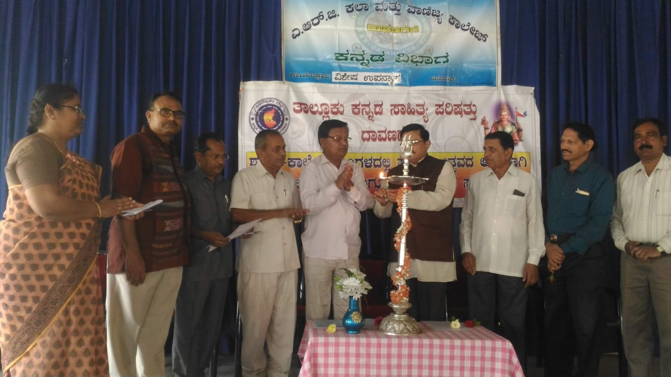
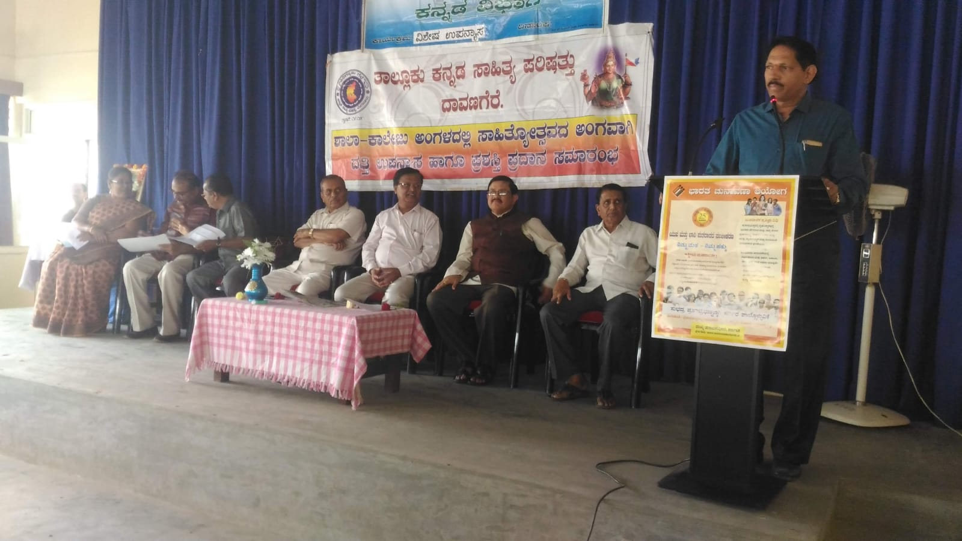
DEPARTMENT POGRAM PHOTOS
Kannada Sahitya Parishath
Datti Lecture -2017-18

Slide 26
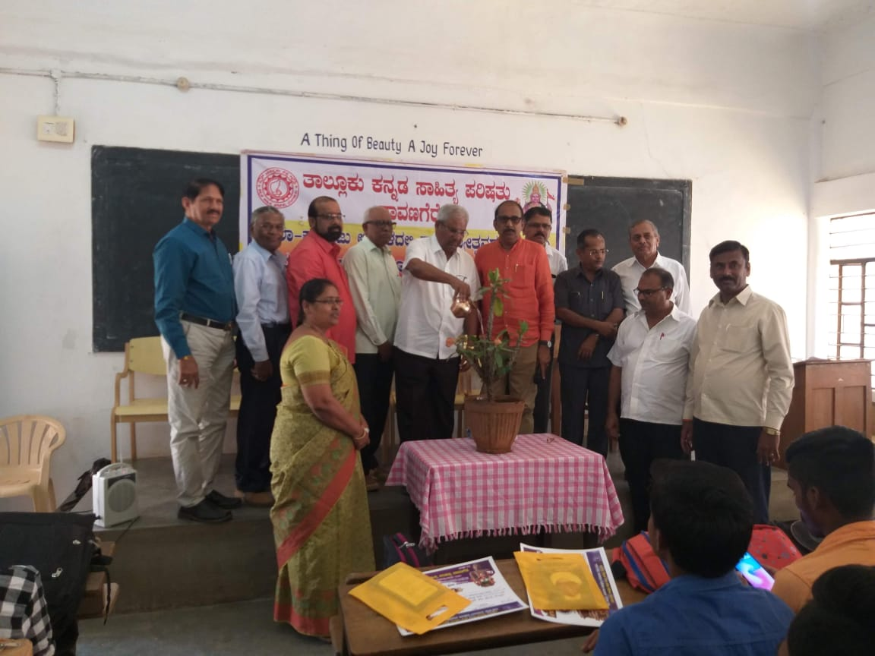
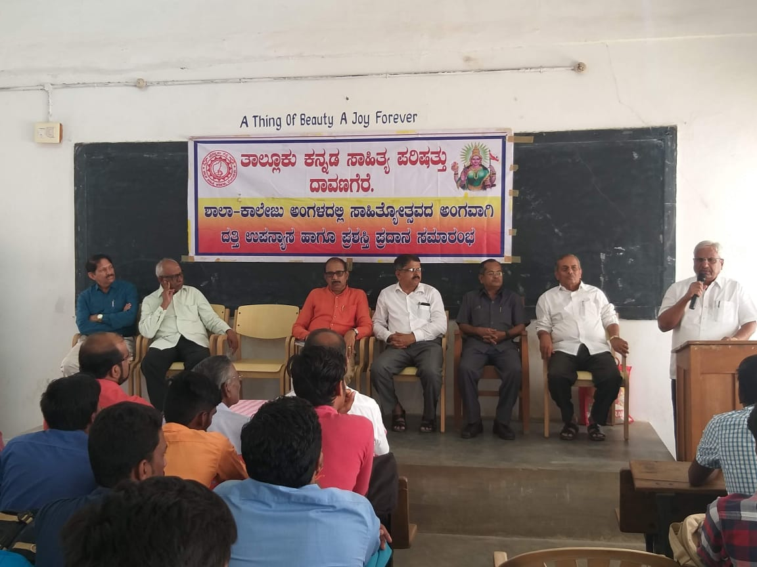
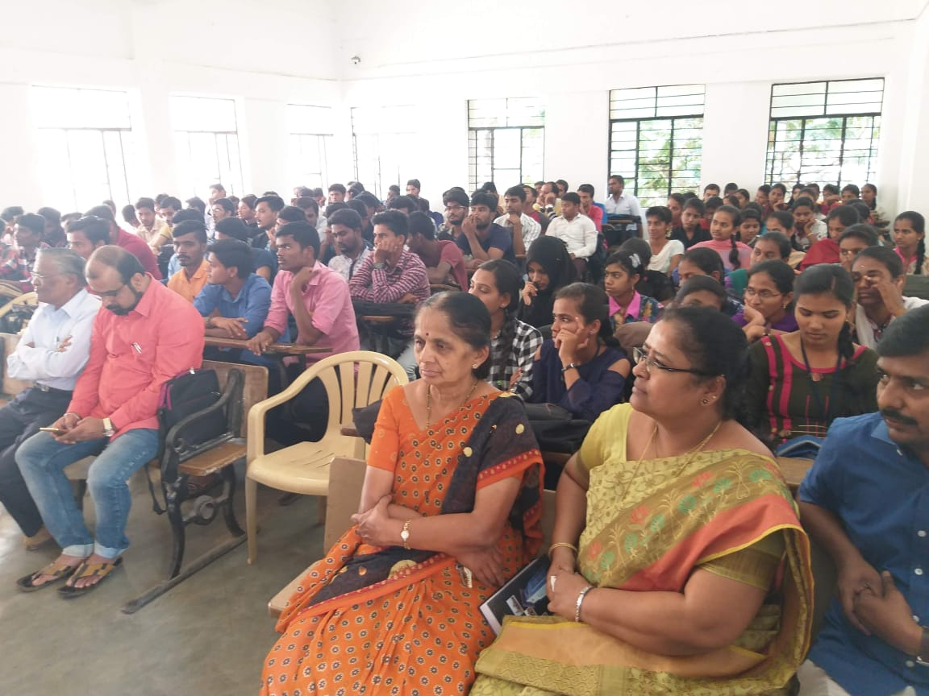
Taluku Kannada Sahitya Parishath ;
Endowment Lecture -2018-19

Slide 27
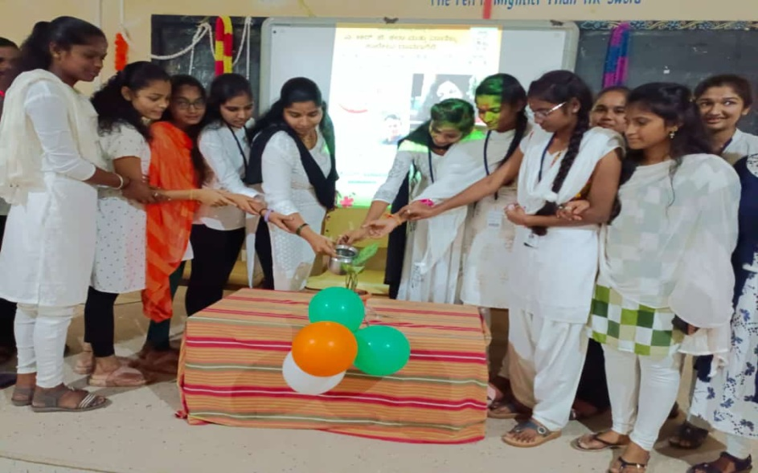
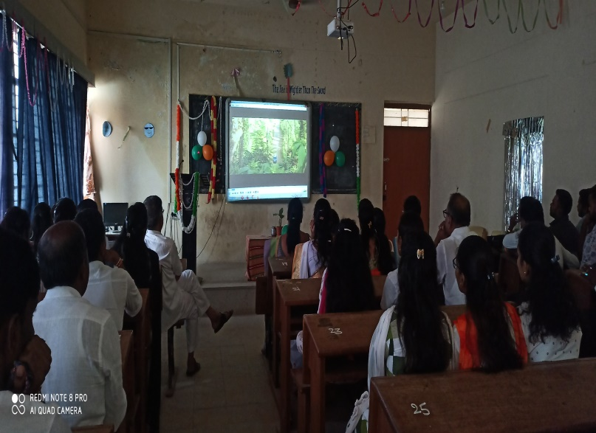
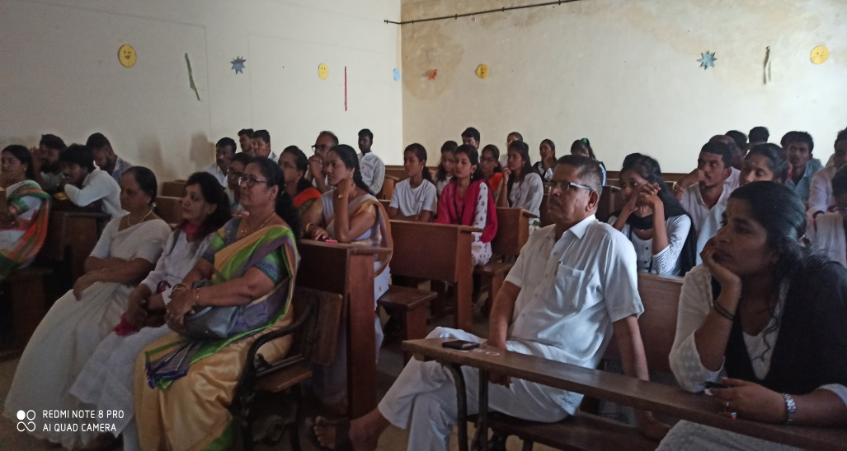
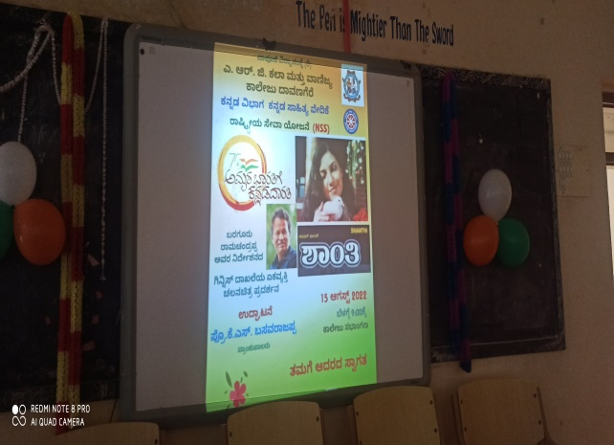
SANTHI - GUINNESS RECORD MOVIE

Slide 28
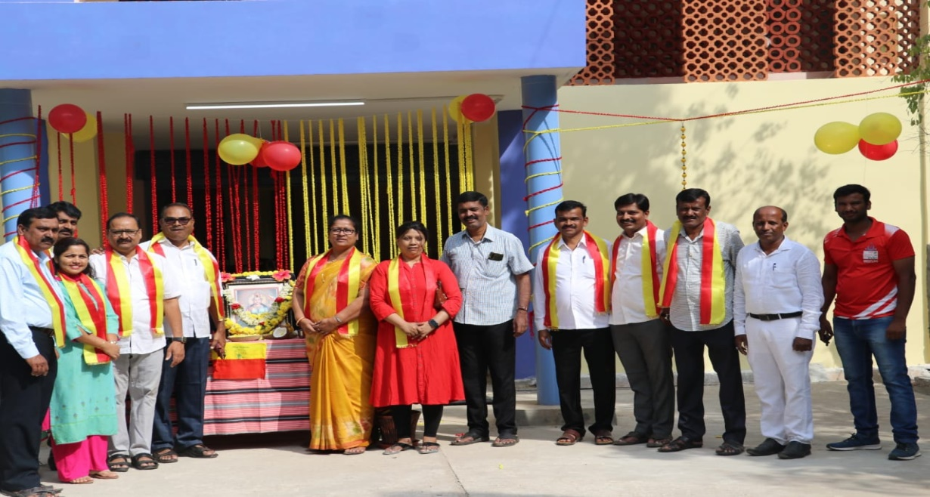
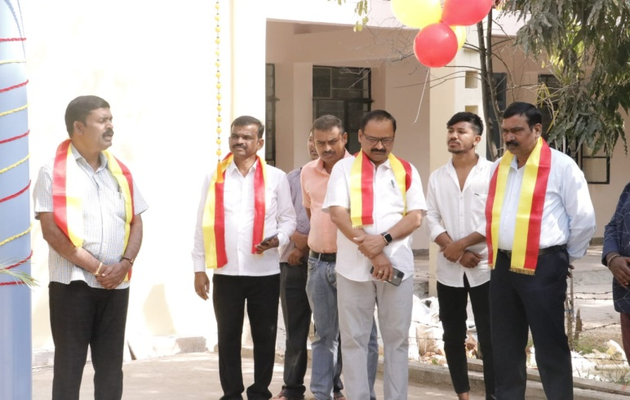
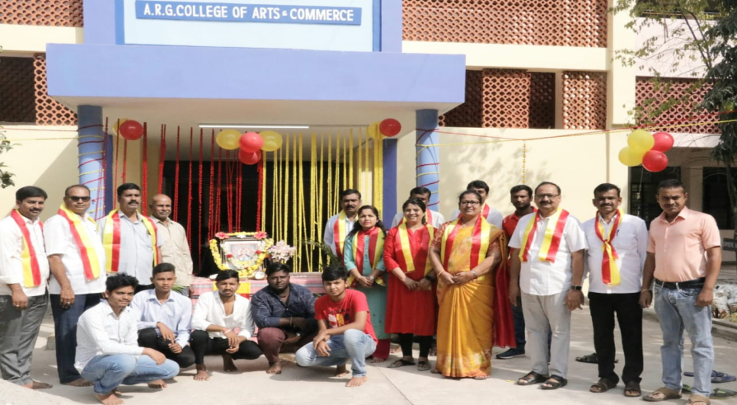
Kannada Rajothasva -2022

Slide 29
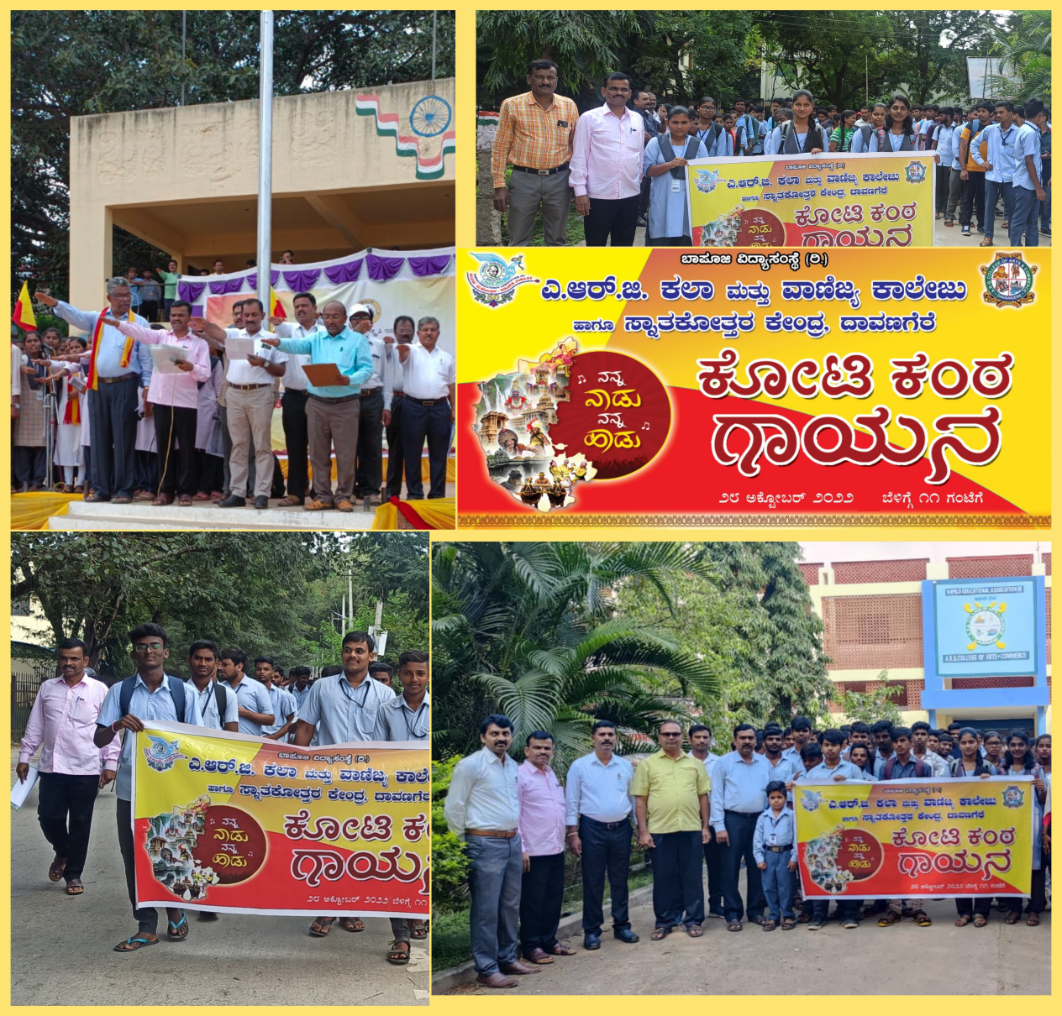
Koti Kanta Geetha Gayana

Slide 30
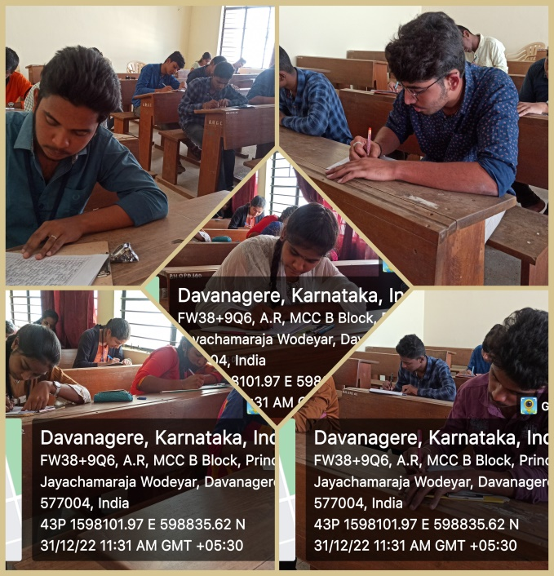
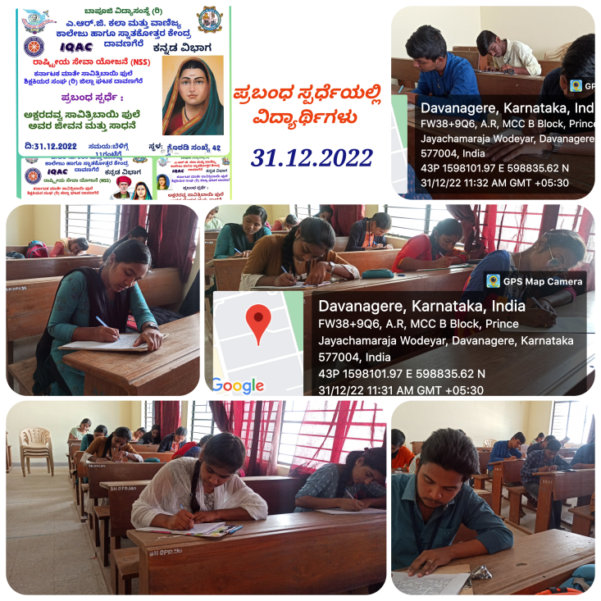
Essay Writing Swatantrada Amrutha Mahotsava

Slide 31

Kalyanadali kataleyanu bittu hoda

Slide 32

THANK
YOU

